Slide 1


SPECIAL PROGRAMS SYSTEM
Password Reset for External Users

Slide 2
CBO’s Login
The Special Programs System has been updated with DOE Single Sign-On as part of DIIT Access & Authorization (A&A) Modernization initiative. Now you are able to access The Special Programs System by using the newly issued DOE credentials.
After your login credentials are established, and you need to update your password, please follow the helpful steps here outlined.

Slide 3
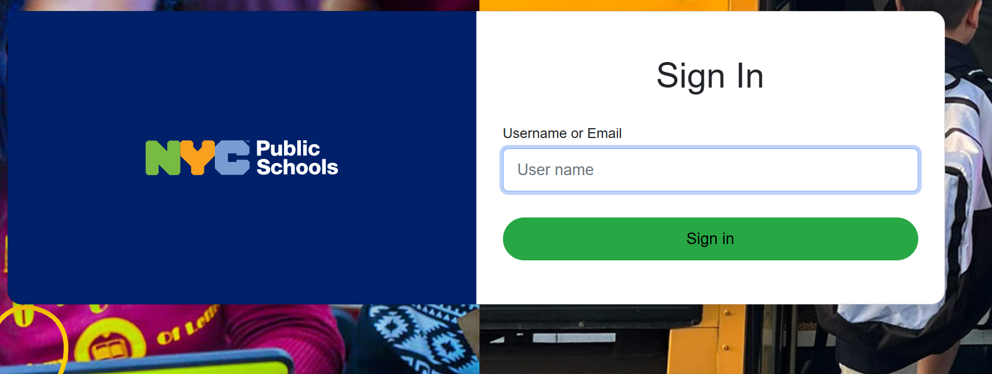
CBO’s Password Reset
https://www.opt-osfns.org/osss/resources/OpenId
Click on link to reach login page
Enter your DOE external account/email address and click on Sign In tab

Slide 4
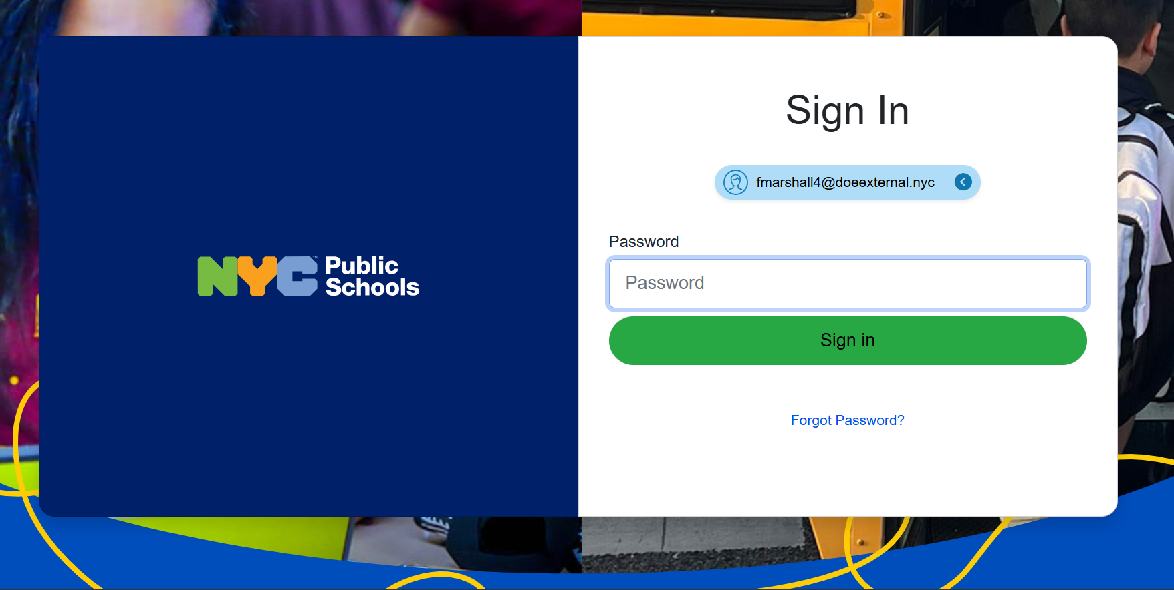
CBO’s Password Reset
Do not enter password on this page
Click on Password and Profile Management just below Sign In tab

Slide 5
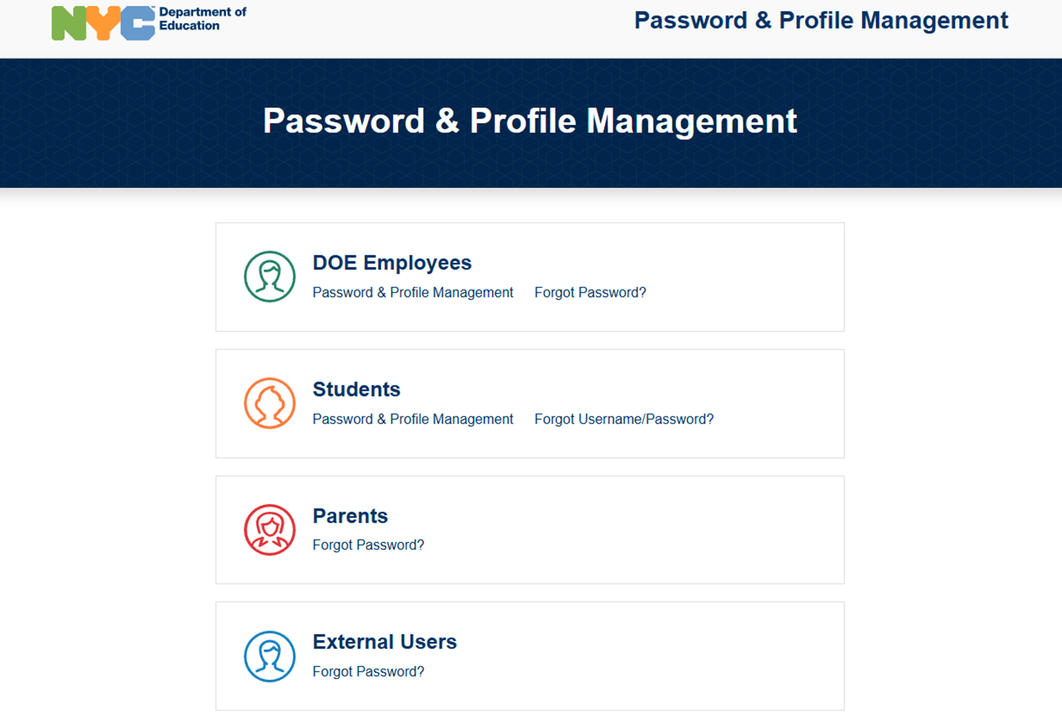
CBO’s Password Reset
In the Password & Profile Management screen select
External Users Forgot Password?

Slide 6
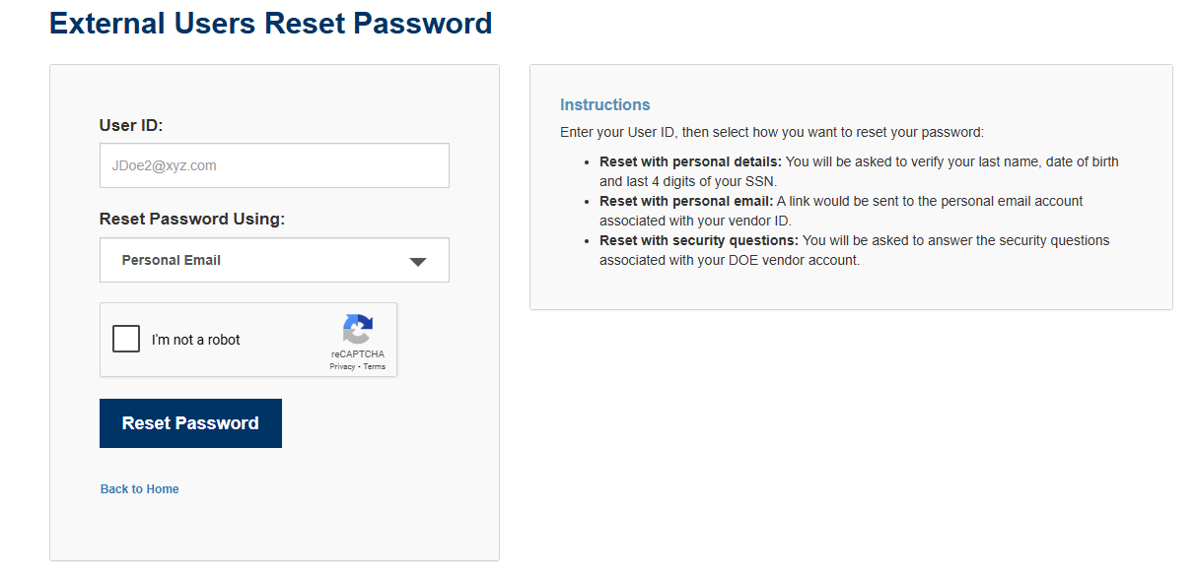
CBO’s Password Reset
In the External Users Reset Password screen read and follow instructions.
Provide your newly assigned DOE user ID
Provide the email address associated with your account as submitted on your Organization profile.
Check the I’m not a robot box and follow the prompts to select the images
Click on Reset Password Tab

Slide 7
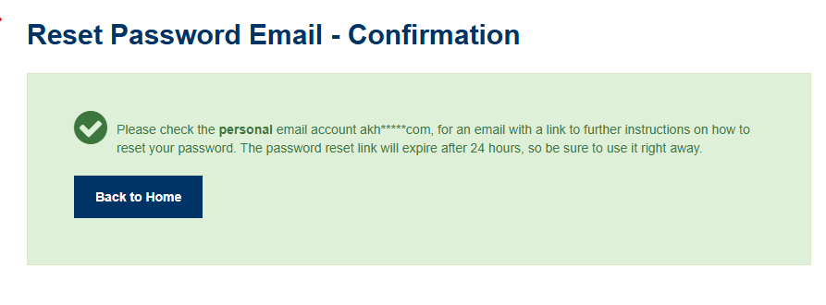
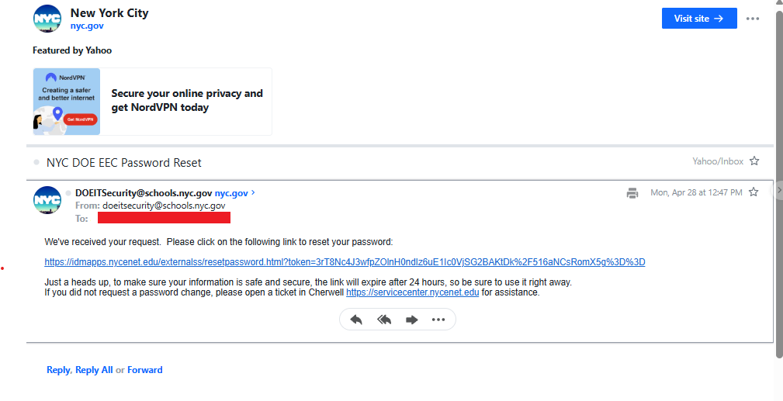
CBO’s Password Reset
After you click on the Reset Password Tab you will see a pop-up box like the one below
Check your inbox for an email with further instructions and link to assign the new password. You have 24 hours to complete the process before the link expires.

Slide 8
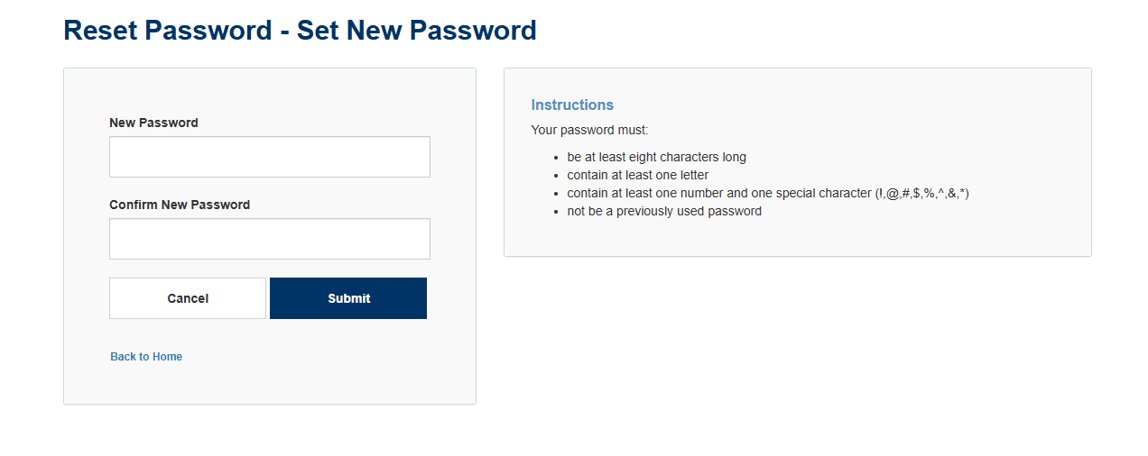
CBO’s Password Reset
Please click on the link that was emailed, you will see the Reset Password screen, read and follow instructions to set your new password.
Enter new password following the criteria below
Confirm the new password
Click submit
Your will receive an onscreen message that your password was reset successfully
Proceed to login to Special Programs System in the link https://www.opt-osfns.org/osss/resources/OpenId

Slide 9
CBO’s Password Reset
If you may need further assistance with the Reset Password, contact Special Programs Unit at:
718-707-4320
Or Email Id: SF-SpecialPrograms@schools.nyc.gov

