Slide 1


Multi-Factor Authentication (MFA)

Slide 2
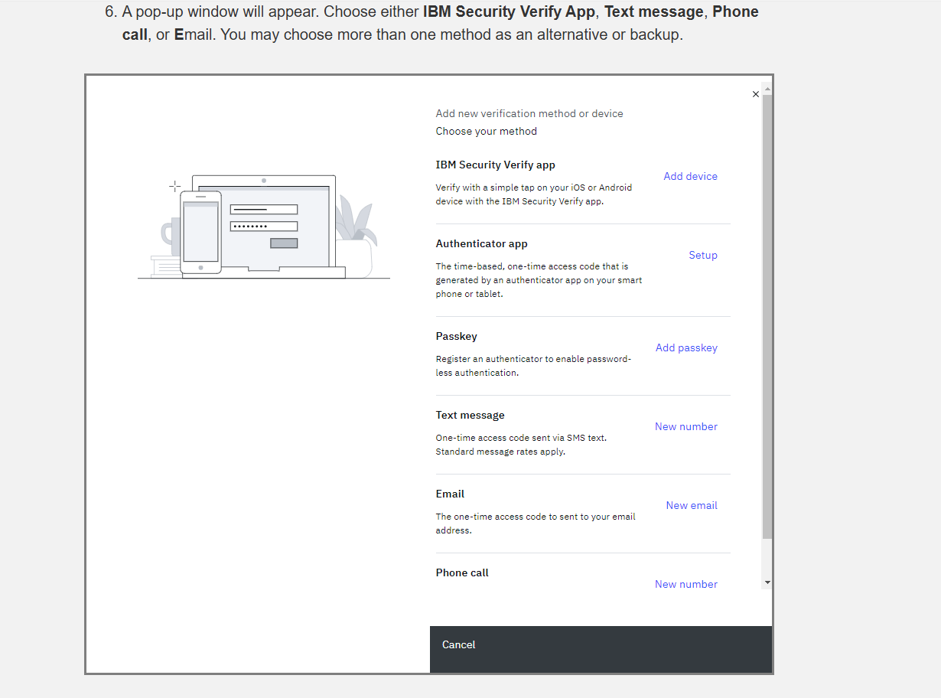
External User Procedure to Log In for the First Time
Upon logging in with the newly created credentials for the first time, the system will ask to change your password.
After changing your password, you will be asked to set up Multi-Factor Authentication (MFA)
See the steps for setting up MFA below

Slide 3
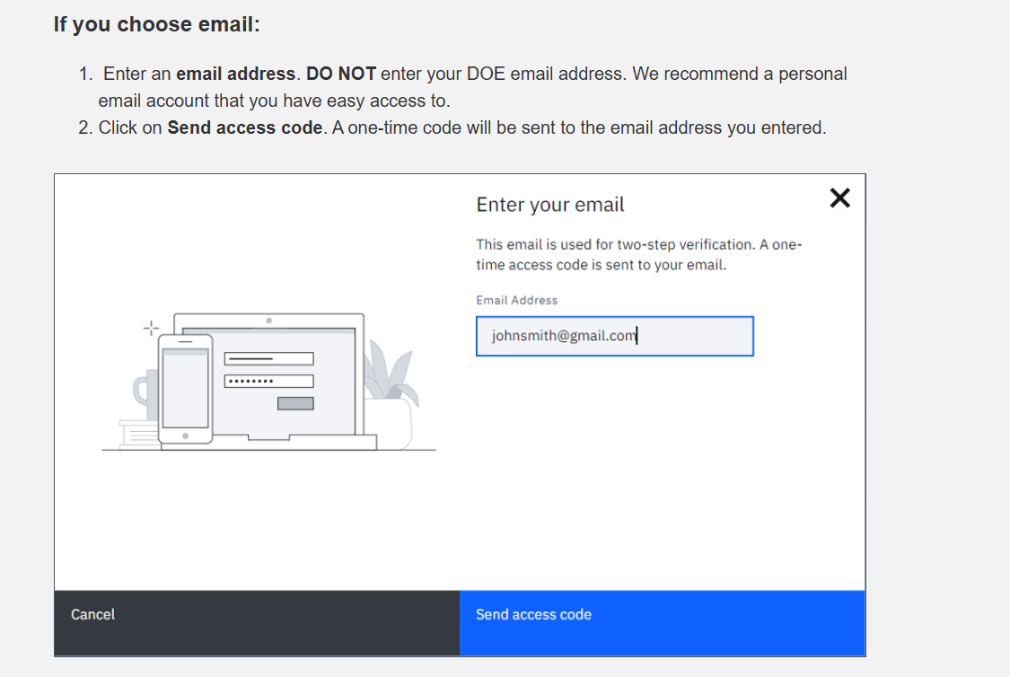
Email Set Up

Slide 4
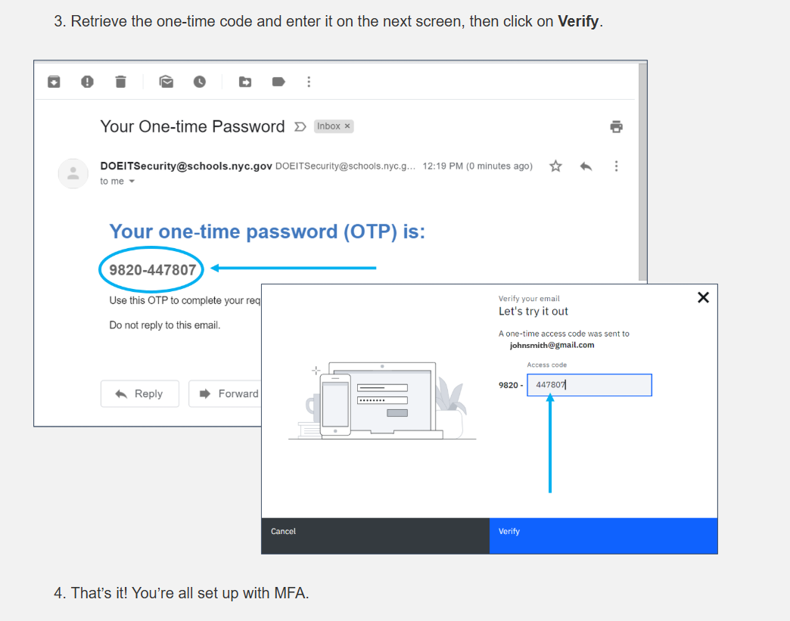

Slide 5
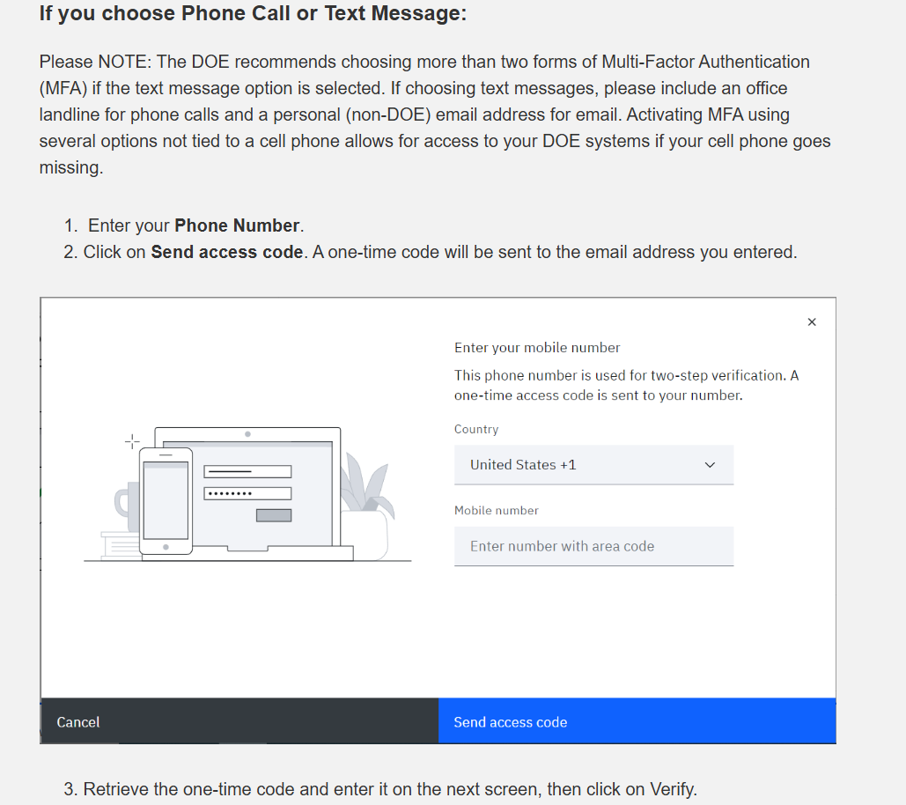
Phone Call or Text Message

Slide 6
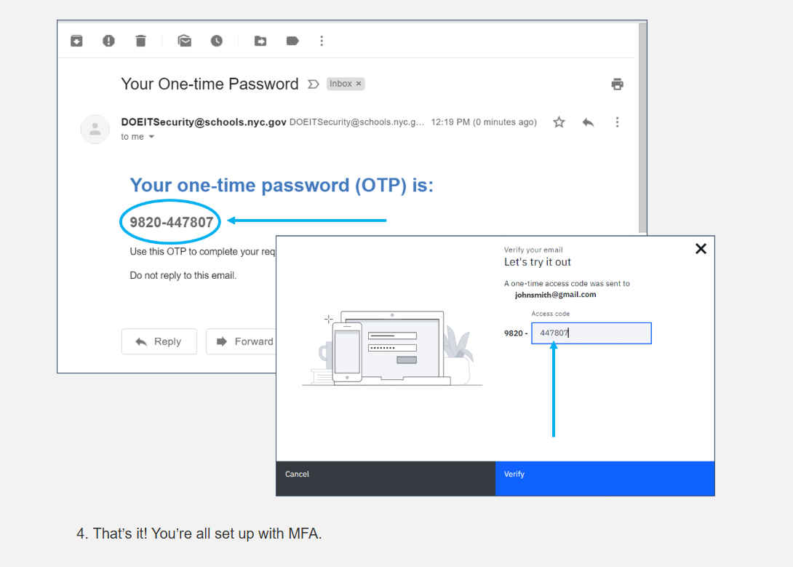

Slide 7
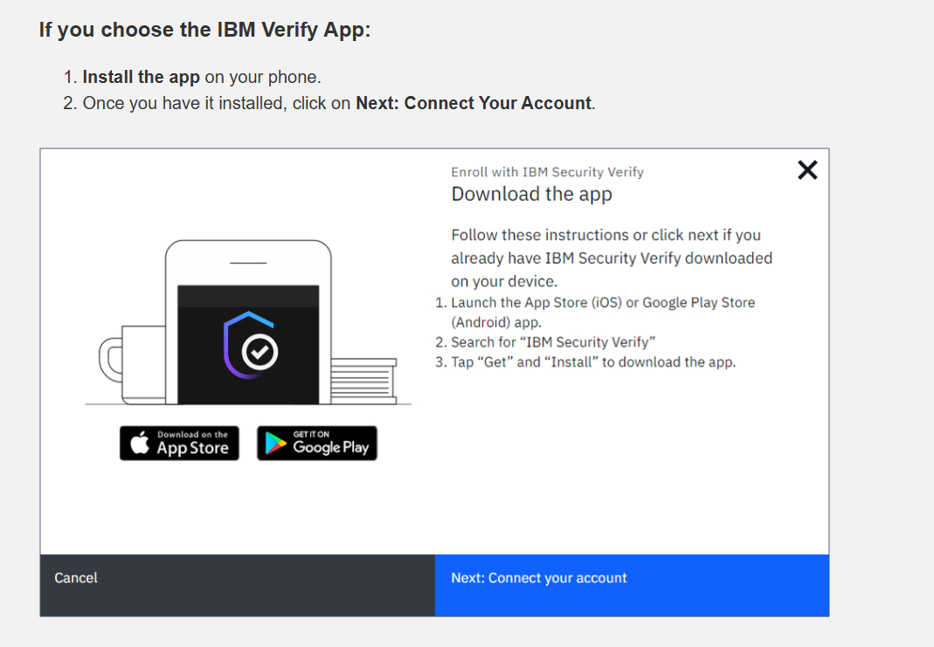
IBM Verify App

Slide 8
